Slide 1
ASR Recreational Vehicle Rentals
Jadala, Archana (50183845)
Cherukuri, Sahithya (50191955)
Loganathan, Raghuvaran (50188677)

Slide 2
ASR RECREATIONAL VEHICLE RENTALS
Project is based on rentals of recreational vehicles (RV)
Mainly focused on the database design of ASR RV Rentals
Design an efficient database to achieve
Faster retrieval of data
Database Normalization
Maintain relationship between entities

Slide 3
FEATURES & BENEFITS
Book recreational vehicles via mobile app, website, or by walking into any branch
User can select type of RV while booking
Discounts are provided for customers and can be used while booking
Customer can add additional drivers if required at the time of booking
Payments can be made online or at branch
Every booking comes with insurance
Target Audience
Customers who are looking for an outing with family and friends and in need of a recreational vehicle

Slide 4
ASSUMPTIONS
Insurance provider gives insurance for each booking and each booking Id will have only one insurance
Each booking will be rented with only one vehicle at a time
Every booking id will have at least one customer and it will have at least and at most one status
We considered there will be two types of employee one who are working as supervisor and second on representative
Each bill belongs to only one booking Id and each booking Id can hold many bills
We assume that a discount can or cannot be used by a customer depending upon the validity of date
We make sure that vehicle on break down would be replaced

Slide 5
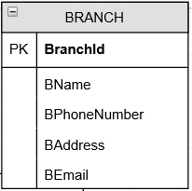
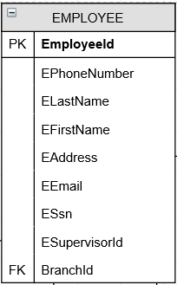
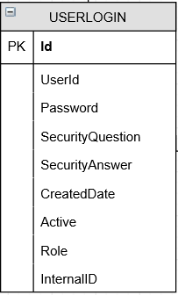
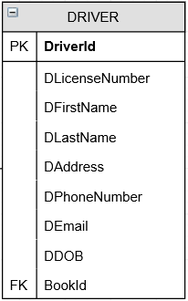
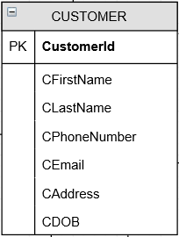
ENTITIES WITH ATTRIBUTES

Slide 6
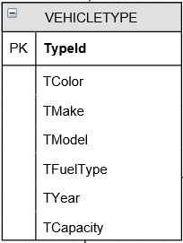
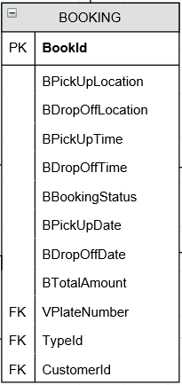
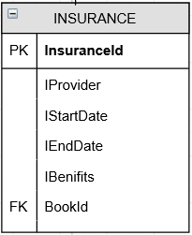
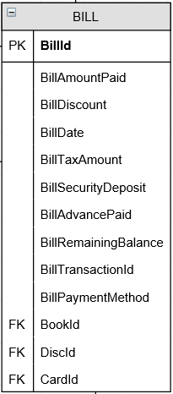
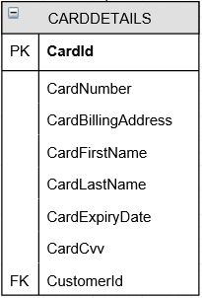
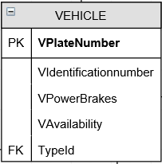
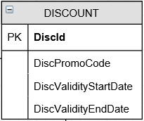
ENTITIES WITH ATTRIBUTES CONTINUED...

Slide 7
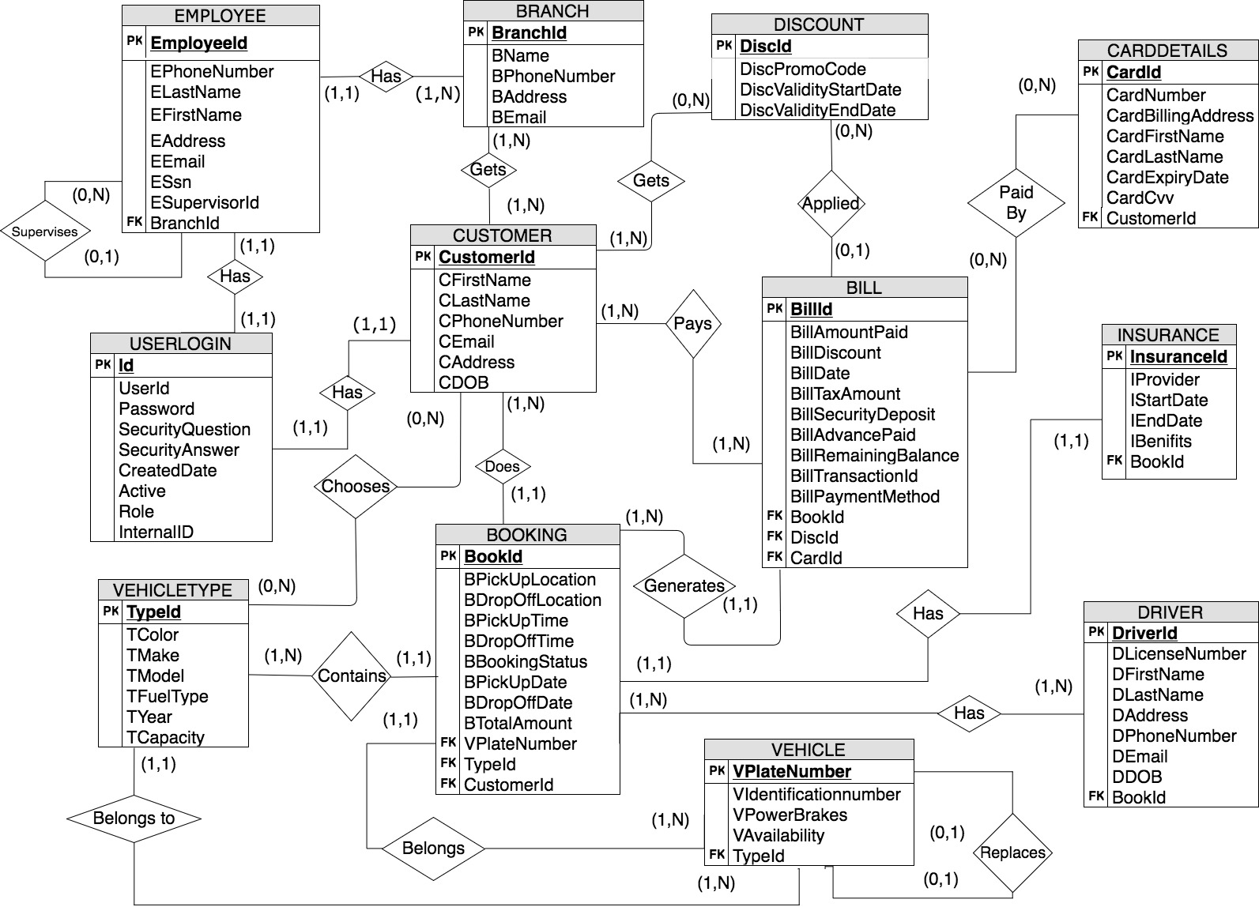
ER DIAGRAM

Slide 8
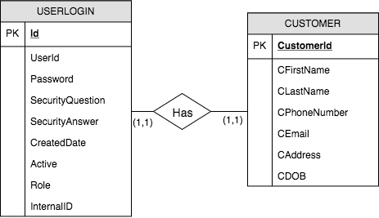
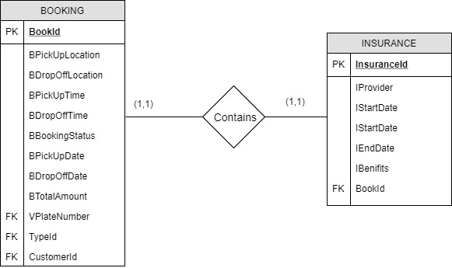
ONE-TO-ONE BINARY RELATIONSHIP

Slide 9
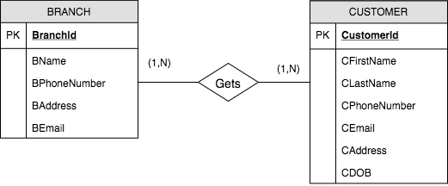
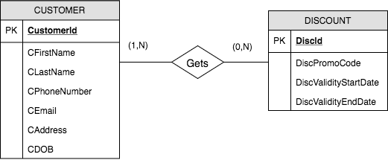
MANY-TO-MANY BINARY RELATIONSHIP

Slide 10
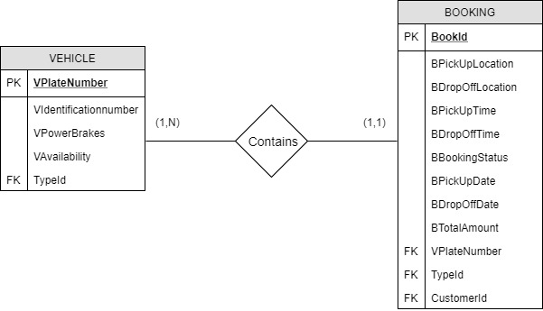
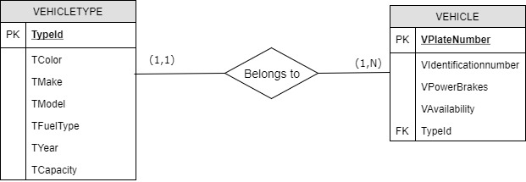
ONE-TO-MANY BINARY RELATIONSHIP

Slide 11
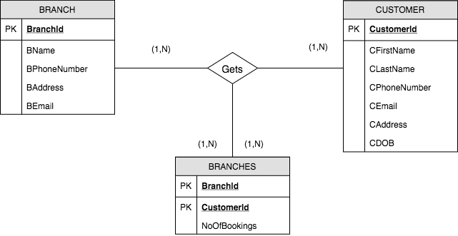
INTERSECTION DATA OVER MANY-TO-MANY BINARY RELATIONSHIP
Intersection data between Many-to-Many Binary Relationship of Branch and Customer tables.
Branches will have Branch ID, CustomerID and No of Bookings as attributes.

Slide 12
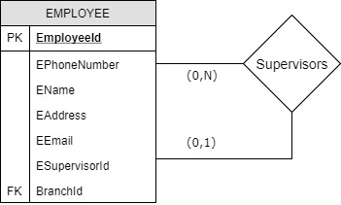
ONE-TO-MANY UNARY RELATIONSHIP

Slide 13
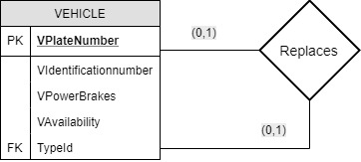
ONE-TO-ONE UNARY RELATIONSHIP

Slide 14
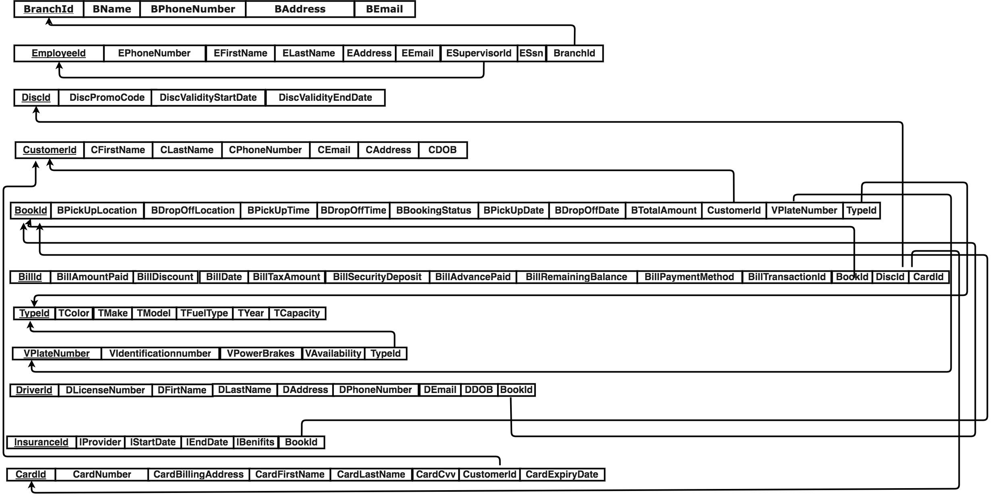
REFERENTIAL INTEGRITY RULES

Slide 15
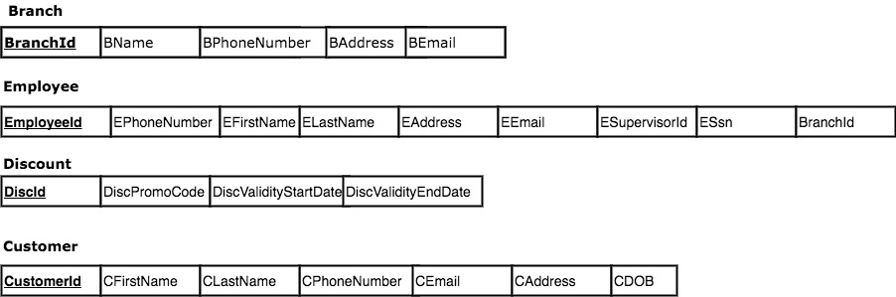
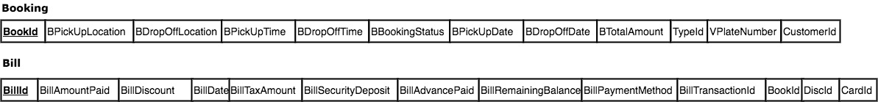
TABLES WITH PRIMARY KEYS

Slide 16
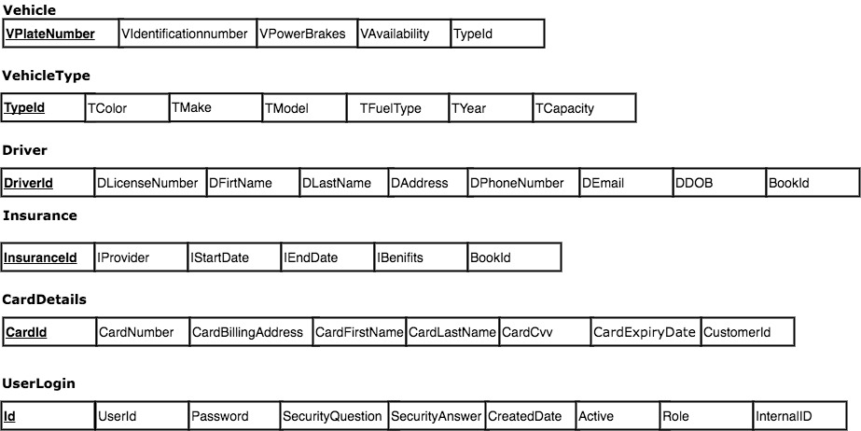
TABLES WITH PRIMARY KEYS CONTINUED..

Slide 17
NORMALIZATION RULES
Normalization Rules:
Initial ER diagram normalized to tables mentioned in step 8. Tables comply 1NF,2NF and 3NF.

Slide 18
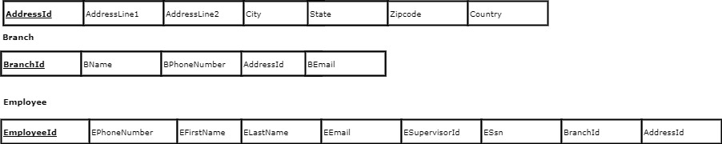
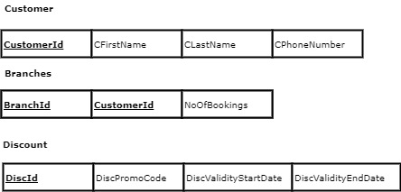
TABLES AFTER NORMALIZATION

Slide 19
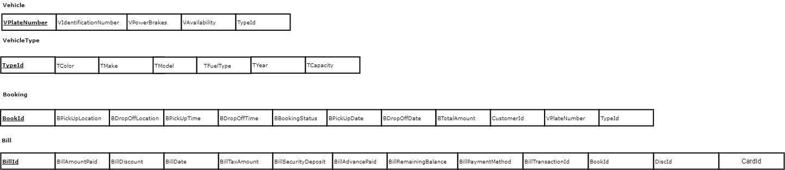
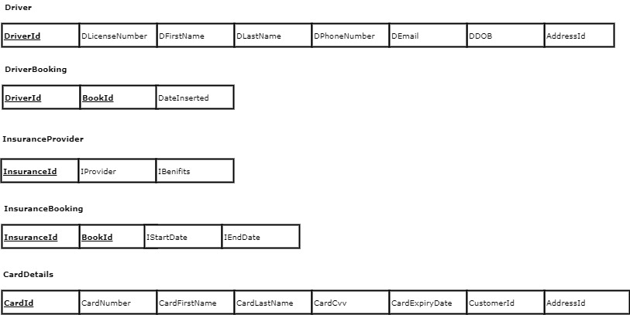

Slide 20
TABLE CREATION USING SQL CODE AND DATA INSERTION
Following Tables are created in SQL and data are inserted into them.
Branch 2. Customer
3. VehicleType 4. Vehicle
5. Driver 6. Booking
7. Bill 8. Discount
9. Insurance 10. Employee
11. CardDetails

Slide 21
PRIMARY KEY & WHERE STATEMENT
Primary keys
SELECT CustomerId FROM Customer;
SELECT BookId FROM Booking;
SELECT BillId FROM Bill;
SELECT commands with WHERE statement.
SELECT CFirstName,CLastName,CEmail
FROM Customer
WHERE CustomerId=2;
SELECT DLicenseNumber,DFirstName,DLastName,DPhoneNumber,DEmail
FROM Driver
WHERE DriverId=3;

Slide 22
GROUPBY STATEMENT
Total amount paid for each booking
SELECT BookID, SUM(BillAmountPaid)
FROM Bill
GROUP BY BookId;
Get the number of bookings made by each customer
SELECT CustomerID, COUNT(BookID)
FROM Booking
GROUP BY CustomerID;

Slide 23
HAVING STATEMENT
Get all the customer IDs who made more than one booking
SELECT CustomerID, COUNT(BookID)
FROM Booking
GROUP BY CustomerID
HAVING COUNT(BookID)>1;
Get all the bookings where there are more than one payments/bills
SELECT BookID,COUNT(BIllID)
FROM Bill
GROUP BY BookId
HAVING COUNT(BillID)>1

Slide 24
INNER JOIN
Match the Customer Addresses against the Address table, and get the customer's address
SELECT
Customer.CustomerId,
Customer.CFirstName,
Customer.CLastName,
Customer.CEmail,
Customer.AddressId,
Address.AddressId,
Address.AddressLine1,
Address.AddressLine2,
Address.City,
Address.State,
Address.Zipcode
FROM
Customer
JOIN Address
ON Customer.AddressId = Address.AddressId

Slide 25
LEFT JOIN
Get the vehicle type for each vehicle
SELECT
VPlateNumber, VAvailability, TColor, TMake
FROM
Vehicle
LEFT JOIN VehicleType
ON Vehicle.TypeId = VehicleType.TypeId;

Slide 26
ORDER BY
Get all the bookings having bills and order by highest bill amount paid
SELECT
Booking.BookID,
Booking.BookingStatus,
Booking.BPickUpLocation,
Booking.BDropOffLocation,
Bill.BillAmountPaid
FROM Booking
JOIN Bill
ON Booking.BookId = Bill.BookId
ORDER BY Bill.BillAmountPaid DESC;

Slide 27
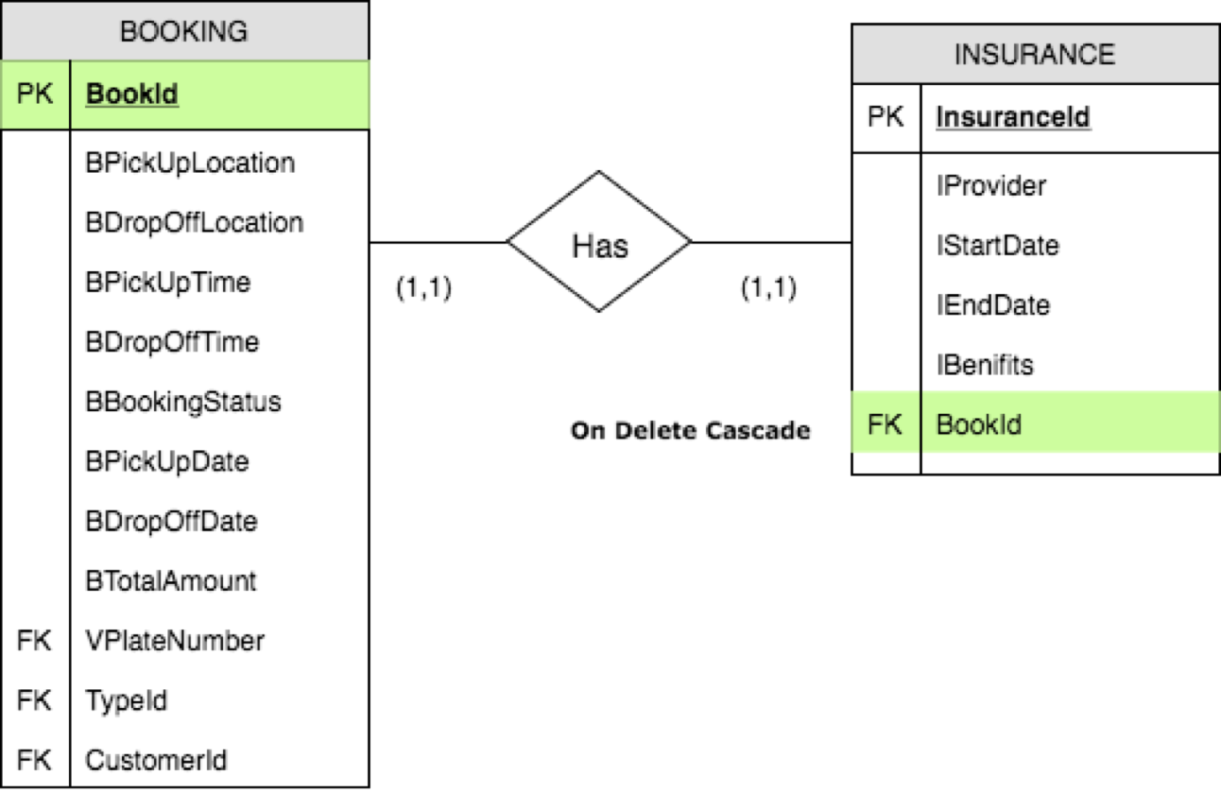
CASCADE DELETION RULE

Slide 28
CASCADE DELETION RULE CONTINUED...
Deleting BookId 4 results in deleting bill details from bill, and also InsuranceBooking for that booking.
DELETE FROM BOOKING WHERE BOOKID = 4;

Slide 29
UNION STATEMENT
Get all the Employees and Customers Addresses
SELECT
'EmployeeAddress' AS AddressType, City, State
FROM Address
WHERE AddressID IN (SELECT AddressID FROM Employee)
UNION
SELECT
'CustomerAddress' AS AddressType, City, State
FROM Address
WHERE AddressID IN (SELECT AddressID FROM Customer)

Slide 30
CREATE VIEW
View to check bookings and booking status by each customer
CREATE VIEW CustomerBookings AS SELECT Customer.CustomerID, Customer.CFirstName, Customer.CLastName, Booking.BookId, Booking.BookingStatus FROM Customer LEFT JOIN Booking ON Customer.CustomerId = Booking.CustomerId

Slide 31
TRUNCATE and DROP
DELETE FROM InsuranceProvider WHERE InsuranceId > 0;
DROP TABLE InsuranceProvider;
Delete from statement deletes all rows from a table.
DROP deletes the empty table from database.

Slide 32

THANK YOU

